Slide 1

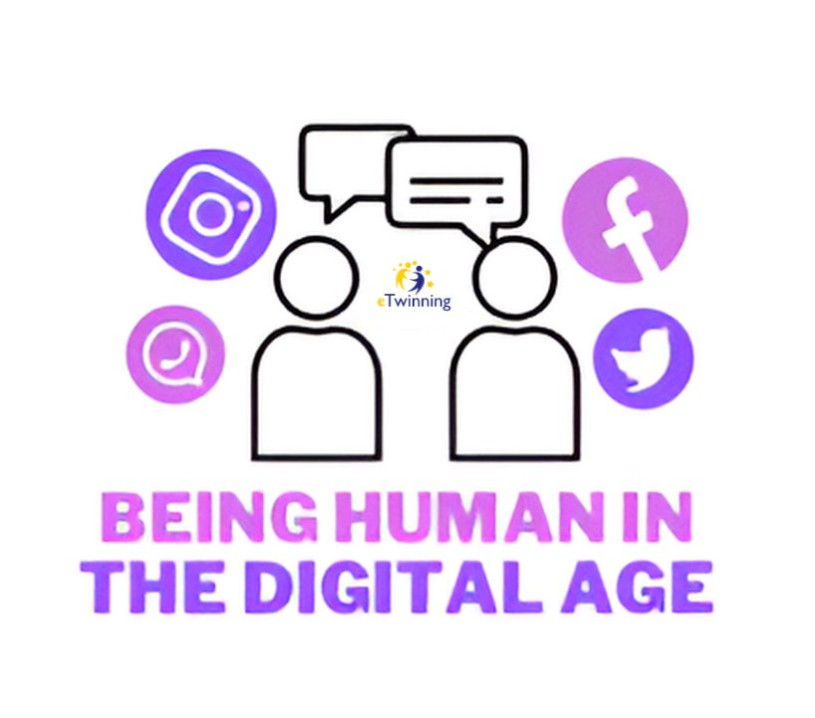
Being Human in the Digital Age
Created by
TEAM POLAND

Slide 2






PROJECT PARTICIPANTS

Slide 3
Challenges of Digitalization
Impact on Human Interaction
Behavioral Changes
Technological Dependence
Digitalization has altered the way humans interact, often leading to reduced face-to-face communication and reliance on virtual mediums. This shift impacts the quality and depth of human connections, potentially leading to social isolation and loneliness.
The digital age has given rise to new behavioral patterns, including shorter attention spans, increased multitasking, and dependence on instant gratification. These changes may influence mental well-being, productivity, and the ability to engage in meaningful relationships.
The widespread adoption of digital technology has led to increased reliance on devices for communication, entertainment, and information. This dependence raises concerns about privacy, security, and the blurring of boundaries between online and offline realities.

Slide 4
Maintaining Human Connection
Preserving Personal Connections
Balancing Virtual and Real
Cultivating Empathy
In a digital world, maintaining meaningful personal connections requires intentional efforts such as scheduling in-person gatherings, prioritizing authentic communication, and actively listening to others to foster empathy and understanding.
Strategies for balancing virtual interactions with real-world experiences are essential to prevent the erosion of genuine human connections. This balance involves setting boundaries, minimizing digital distractions, and engaging in offline activities that nurture relationships and well-being.
The digital age calls for heightened empathy to counteract the potential desensitization to human emotions in virtual interactions. Cultivating empathy involves recognizing and validating feelings, actively seeking diverse perspectives, and engaging in compassionate actions.

Slide 5

Ethical Considerations
Human-Centric Design
Technological Impact on Society
Adopting a human-centric approach to technological development involves aligning innovations with ethical values, prioritizing user well-being, and ensuring inclusive design to accommodate diverse human experiences. Incorporating ethical principles can mitigate potential harms and maximize benefits for humanity.
As technology continues to shape human behavior and societal norms, ethical considerations arise regarding data privacy, digital surveillance, algorithmic biases, and the ethical use of artificial intelligence. Addressing these concerns is paramount to safeguarding human rights and autonomy.

Slide 6

Digital Wellness
Impact on Mental Health
Emotional Regulation
The pervasive digital environment can influence mental health, contributing to issues such as digital addiction, cyberbullying, and information overload. Promoting digital wellness involves fostering mindfulness, establishing healthy tech habits, and seeking support for mental well-being.
Maintaining emotional well-being in the digital age requires developing strategies for emotional regulation, including setting boundaries for online engagement, practicing digital detox, and nurturing real-world connections to foster emotional resilience.

Slide 7

Adaptation and Resilience
Individual Adaptation
Societal Evolution
Navigating the digital age demands individual adaptation by acquiring digital literacy, honing critical thinking skills, and cultivating adaptability to thrive in rapidly evolving technological landscapes. Embracing lifelong learning and agile thinking is crucial for personal resilience.
At a societal level, embracing technological advancements entails fostering digital inclusion, addressing digital divides, and ensuring equitable access to opportunities. Cultivating resilience as a society involves promoting ethical innovation and leveraging technology for collective progress and empowerment.

Slide 8
Empowering Humanity
Levelling the Digital Divide
Harnessing Technology for Good
Cultivating Digital Citizenship
Empowering humanity in the digital age requires addressing disparities in digital access and literacy to ensure equitable participation in the digital era. Bridging the digital divide involves initiatives to provide education, connectivity, and digital skills training to underserved communities.
Inspiring action towards leveraging technology for positive human advancement involves promoting ethical innovation, harnessing the power of technology for social good, and fostering collaboration to address global challenges such as healthcare disparities, environmental sustainability, and social justice.
Fostering responsible digital citizenship involves promoting digital literacy, ethical online behavior, and digital rights awareness. Encouraging active civic engagement and digital advocacy empowers individuals to contribute to a more inclusive, ethical, and humane digital society.

Slide 9

THANK YOU FOR YOUR ATTENTION

